Slide 1

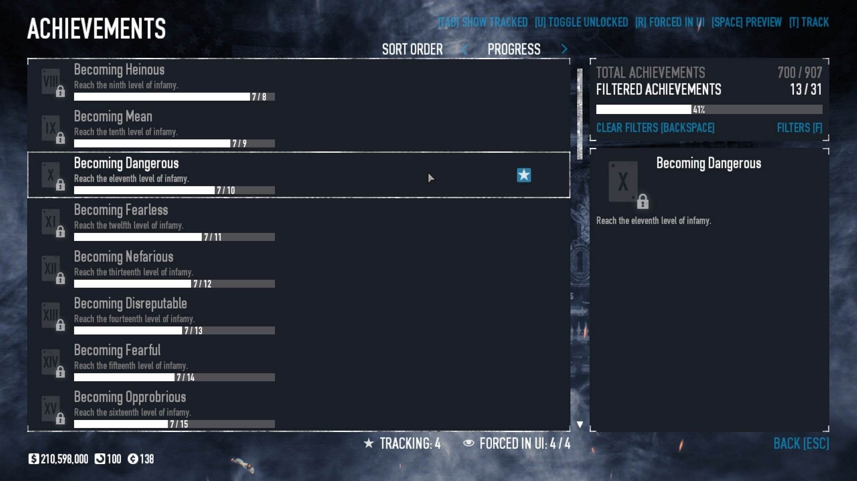


Game Mastery Tracker Luke Davis
https://github.com/ksu-is/PlayPerfect/
All your achievements - in one place

